Slide 1
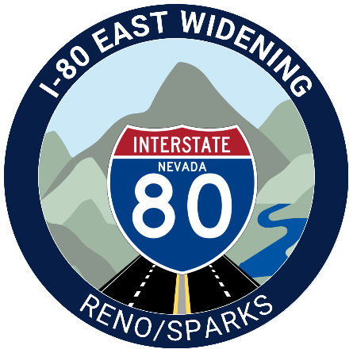
2025 Nevada Transportation Conference
I-80 East Vista to USA Parkway Widening Project
May 14, 2025

Slide 2
Project Area
Interstate 80 (I-80): Vista Boulevard to USA Parkway
Interchanges:
Mustang
Patrick
Lockwood including UPRR bridge
USA Parkway
Vista Blvd.

Slide 3
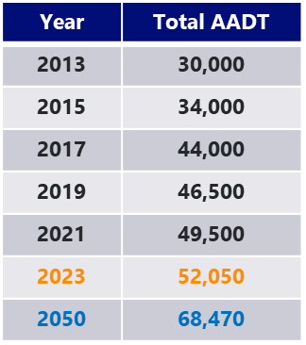
Critical Project Elements
Statewide Crash Rate Comparison | Total Crashes | PDO | Injury | Injury (Type A) | Fatal | Fatalities
Vista to 0.95 miles east of Mustang (Urban) |  |  |  |  |  | 
0.95 mile east of Mustang to USA Pkwy (Rural) |  |  | 
Safety Elements
Widening inside shoulders to 10’
Widening outside shoulders to 12’
Constructing median barrier rail
Upgrading guard rail to concrete barrier rail
Wrong way driver detection
- Corridor exceeds statewide crash rate
PDO – Property Damage Only
Injury (Type A) refers to incapacitating injuries with potential lifelong injuries
2050 Forecasted Volumes
Westbound
3,580 vehicle per hour (PM peak period)
Eastbound
3,059 vehicles per hour (PM peak period)
Traffic Elements
Additional lane in each direction
Interchange improvements
Notes:
TRIC generates 40,000 VPD in 2050 per RTC model

Slide 4
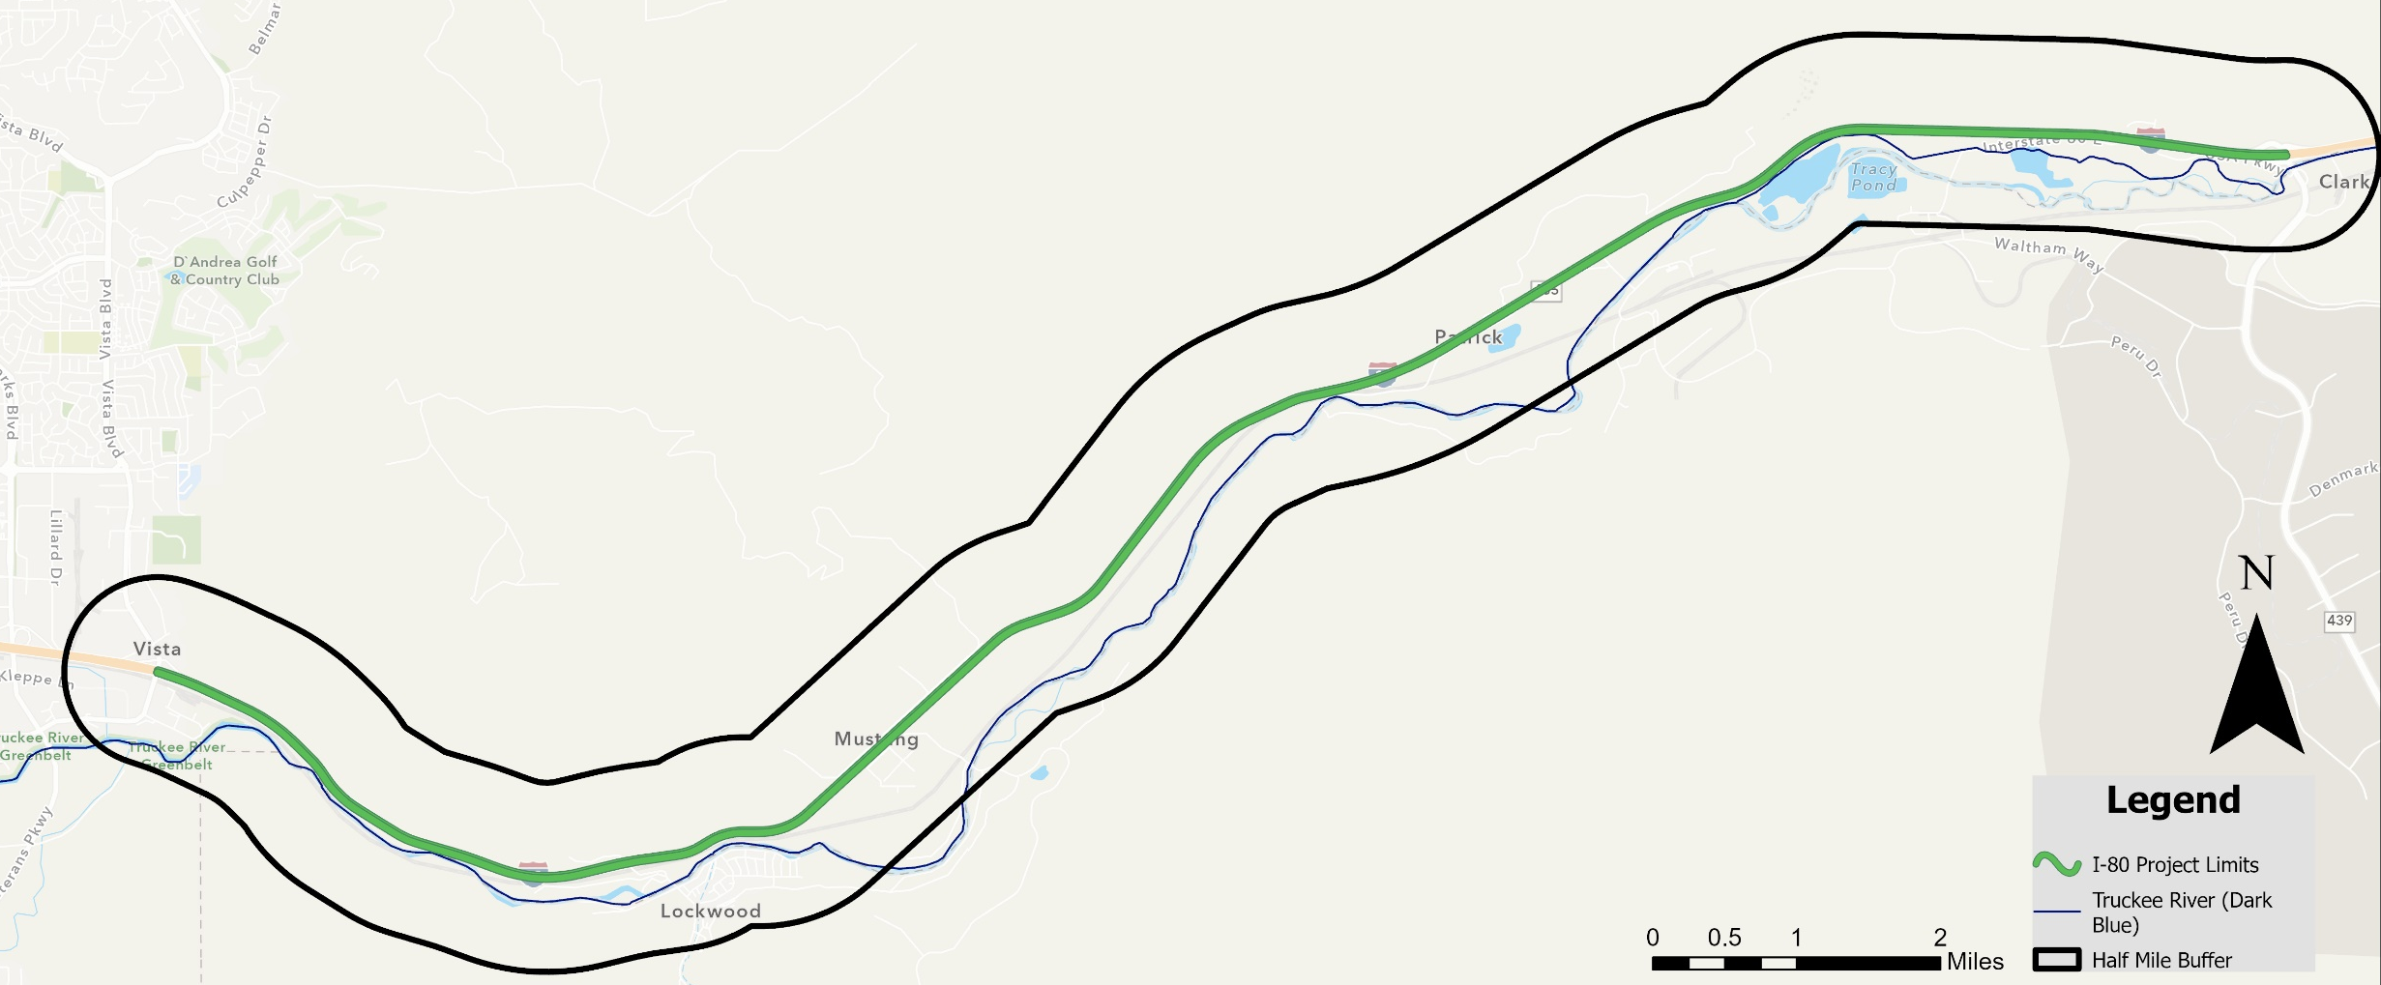
Concept Development and Project Area Constraints
Mountainous terrain elements
Truckee River, UPRR, and Areas of Environmental Concern
Temporary and permanent water quality improvements
Mountainous
Terrain
Cooling Ponds
Temporary and Permanent Water Quality
Mountainous
Terrain
Multiple Environmental Avoidance Areas
Truckee River
UPRR

Slide 6
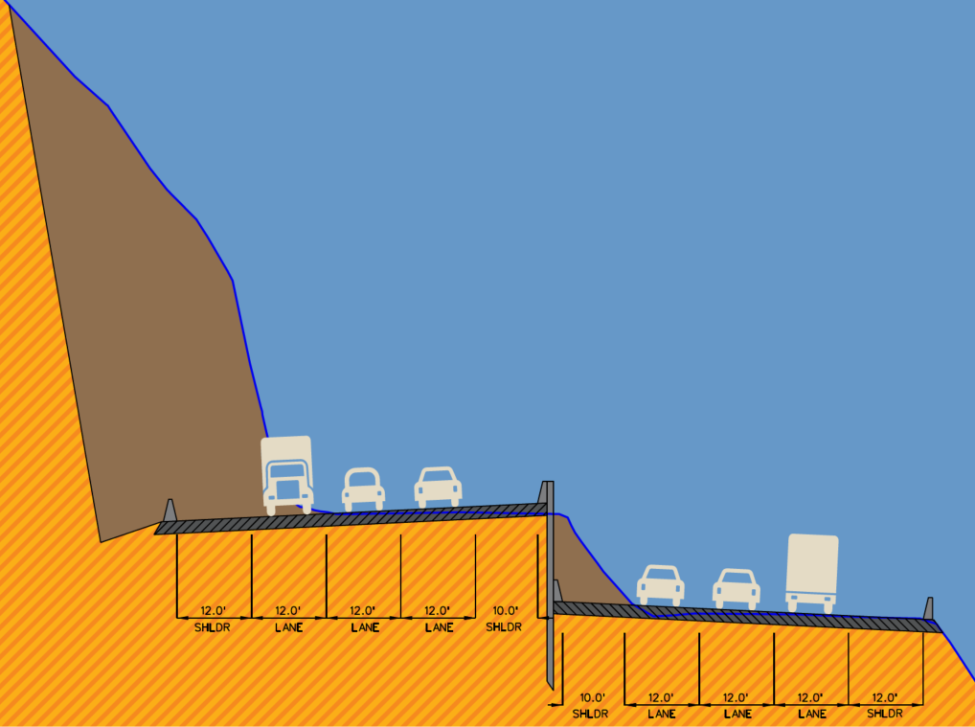
Proposed Build Alternative
Roadway Section
Travel lanes – Three lanes, 12 feet each direction
Inside shoulder – 10 feet
Outside shoulder – 12 feet
Roadway Elevation
Match existing roadway elevations
Raise or lower roadway elevations to minimize impacts
Proposed Slope
Existing Slope
Proposed Retaining Wall
Alternatives are preliminary and subject to change

Slide 7
Key Construction Elements and Risks
Substantial slope cuts and walls
More complex walls – soil nail/rock anchors on north side
Also occurs west of Patrick
Center median wall for a majority of the corridor
Potential construction impacts and additional costs due to proximity to existing/future lanes based on phasing
Drainage
Cross roadway connectivity – phasing challenges
Water quality facilities
Maintenance of Traffic
Increasing traffic volumes

Slide 8
Project Status
NEPA completion anticipated summer 2025
NDOT awarded $275 million INFRA grant for project
$25M pre-construction activities
$250M construction activities
Project development
Program manager procurement
Interim Geotechnical investigation
Progressive Design Build (PDB)

Slide 9
Project Schedule
Key Milestone – September 2027 INFRA Grant Obligation Deadline

Slide 10
Thank You!
I80eastnv.com
Chris Kuhn – NDOT Project Manager
ckuhn@dot.nv.gov
(775) 888-7728

